Slide 1
AP Macroeconomics
Semester 2

Slide 2
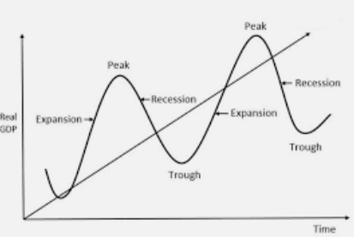
Ask the person next to you about their holiday
What was the best thing and worst thing about their holiday?
  I will pick 3 random people to tell what the other person told them about their holiday.

Slide 3
What to expect: Before AP Exam
Assessment:
Quizzes
  Note: Retakes must be taken within a week of the first attempt
Graphing Homework
Extra Credit Questions/Projects
Class participation
  I will check your books for notes and use this and your behavior to calculate a weekly score
Week 1: Revision, continue Unit 5
Week 2: Finish Unit 5
Week 3-5: Unit 6
Week 6-8: Revision for AP Exam
Week 9: AP Exam

Slide 4
Class Participation
I will give students a weekly score based on their class participation.
Students who are doing any of the following will have their score subtracted.
  Talking
  Using tablets frivolously
  Sleeping
  Not participating despite being asked
  Etc.
I will check your notes to make sure that work has been completed. This will form part of your score.

Slide 5
What to expect: After AP Exam
Week 10: Adam Smith and the Industrial Revolution
Week 11: Karl Marx and Communism
Week 12: Economic Development Case Studies
Week 13: Economic Crises
Week 14: 20th Century Economics
Week 15: Globalization
Week 16: Globalization
Week 17: Incentives, Freakonomics
Week 18: Environmental Economics
Week 19: Nobel Prize Winners
Assessment:
Homework
Projects
Final Exam – Likely will have written question and essay components

Slide 6
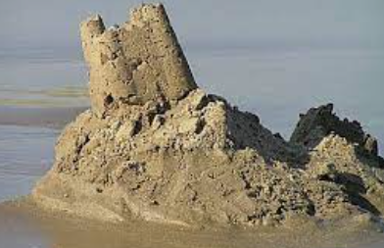
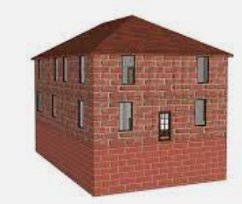

Study Plan
Some of you I recommend meeting with me several times to go over the key concepts from Unit 3 and 4.
  Don’t build sandcastles. A weak foundation makes a poor house.
Come to my office or ask questions via wechat about things you’re unsure of which will save you time and help you build a strong foundation.
I have messaged some of you and I expect you to make an effort.

